Slide 1

PREDICTING CUSTOMER CHURN USING MACHINE LEARNING
SRM INSTITUTE OF SCIENCE AND TECHNOLOGY
SCHOOL OF COMPUTING
DEPARTMENT OF COMPUTING TECHNOLOGIES
18CSP111L - MAJORR PROJECT
Reg.No: RA1911003010391
Name: Samiksha Upadhyay
Guide name: Ms. M.Rajalakshmi
Designation: Assistant Professor Department: C-Tech

Slide 2
Predicting Customer Churn
Introduction
Customer Churn is when a customer decides to stop using services, contents or products from a company
Reasons for customer churn poor customer service, not enough value in a product or service, lack of customer loyalty and lack of communication, etc.
The customer retention is important to a company as it is less expensive than acquiring new customers

Slide 3
Predicting Customer Churn
Abstract
The project aims to figure the customer churn of the year
Predicts the customer churn based on many features of the company and also derive conclusions on how the features affect the company
Data set : Telco Customer Churn taken from Kaggle

Slide 4
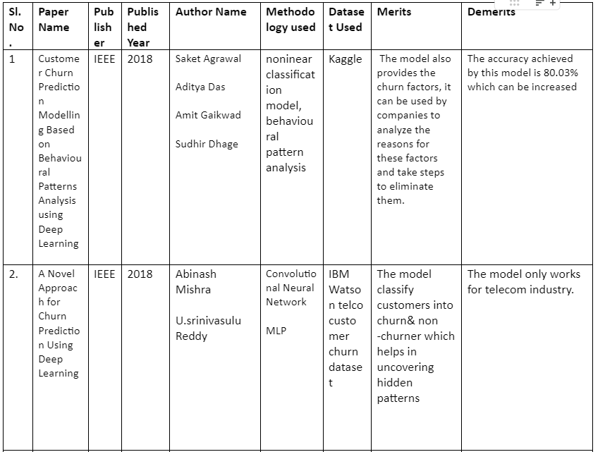
Predicting Customer Churn
Literature Survey

Slide 5
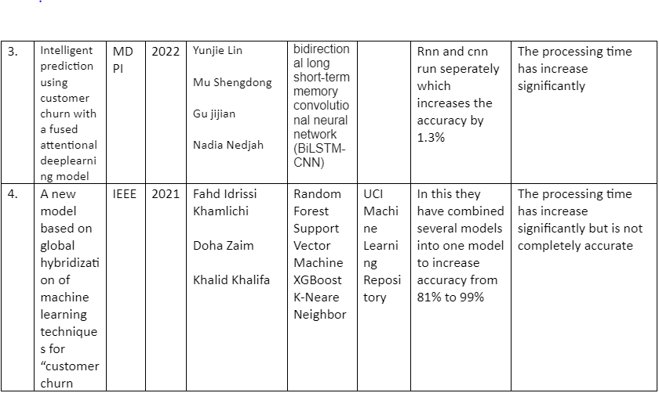
Predicting Customer Churn
Literature Survey

Slide 6
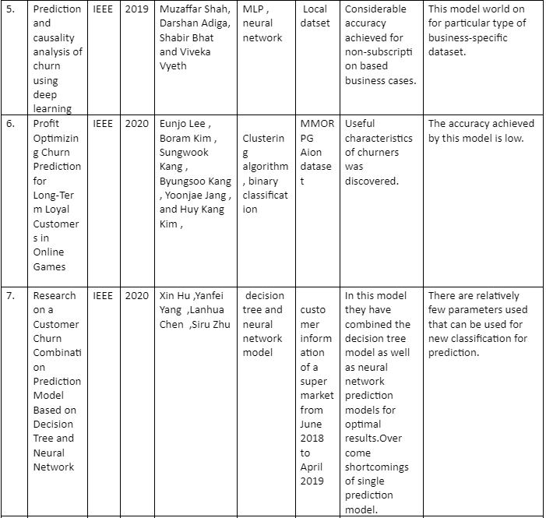
Predicting Customer Churn
Literature Survey

Slide 7
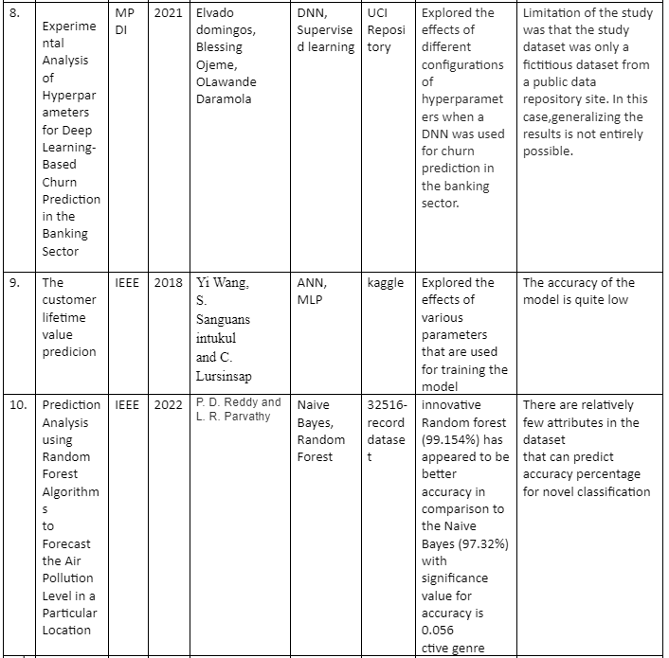
Predicting Customer Churn
Literature Survey

Slide 8
Predicting Customer Churn
Existing Methodology
Organizations have a traditional approach to churn prediction, which involves manual data analysis, a small number of features, and simple statistical models.
Lack accuracy and efficiency, leading to poor business decisions and customer retention strategies.
Businesses gather relevant data from various sources, such as customer interactions, transaction history, and demographic information. This data is stored and organized in databases or data warehouses and most of this is done manually.

Slide 9
Predicting Customer Churn
Proposed Methodology
We are prepared to construct many models in search of the optimum fit.
Forecasting customer turnover is a problem of binary classification since clients can leave or stay for a predetermined amount of time.
We’ll be testing :
- Logistic Regression
- Naïve Bayes
- Decision Tree
- SVM

Slide 10
Predicting Customer Churn
Problem Identification and Description
Customer turnover is an important aspect for a Business’ revenue. Retaining older customer is cheaper and more cost efficient then gaining new ones every year.
It is important for a company to find out what features of theirs is contributing towards customer churn.
In this project we will try to make a predictive model which will help the company in figuring out the right features, using the most accurate machine learning model.

Slide 11
Predicting Customer Churn
Scope
Can apply to many different industries and business models. Some examples of industries that commonly use churn prediction include telecommunications, e-commerce, software as a service (SaaS), and financial services.
Machine learning algorithms can analyze large amounts of data to identify patterns and trends in customer behavior that may indicate a customer is likely to churn.
Machine learning models can be trained on historical data to predict which customers are most likely to churn in the future.

Slide 12
Predicting Customer Churn
Challenges
Data quality: Machine learning algorithms require high-quality data to produce accurate predictions.
Feature selection: Choosing the right features to include in the model can be challenging. If the wrong features are selected, the model may not accurate
Model complexity: Machine learning models can be complex, making it difficult to understand how they arrived at their predictions.
Implementation challenges: Implementing a churn prediction system can be challenging, as it requires significant investment in data infrastructure, software development, and training.
Ethical concerns: There are ethical concerns surrounding the use of machine learning for churn prediction, particularly around issues of privacy and data security.

Slide 13
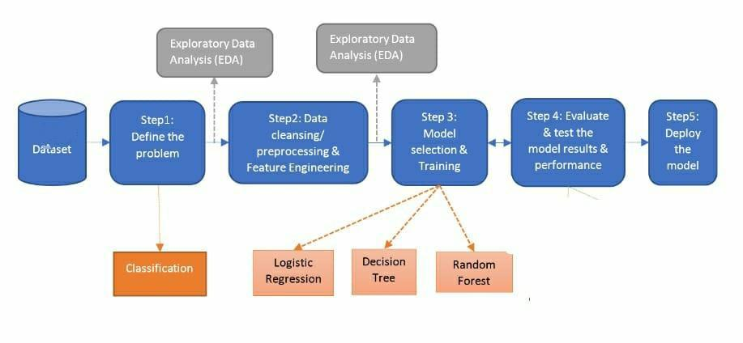
Predicting Customer Churn
System Architecture and Design

Slide 14
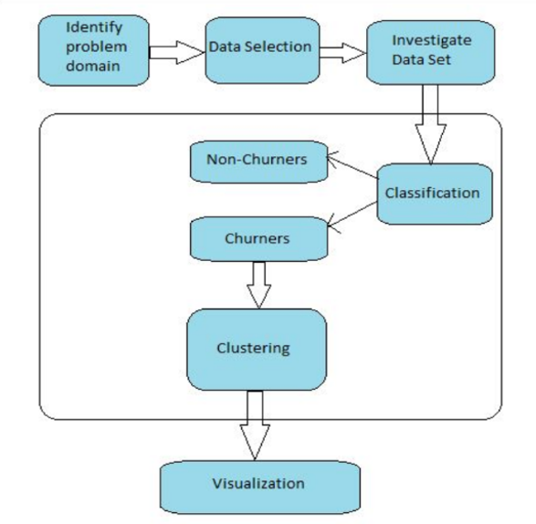
Predicting Customer Churn
System Architecture and Design

Slide 15
Predicting Customer Churn
Module Description
Data Preprocessing
Data Evaluation
Model Selection
Model Evaluation
Model Improvement
Future Predictions

Slide 16
Predicting Customer Churn
1. Data Preprocessing
Steps in data preprocessing include:
Importing Libraries
Import dataset
Evaluate the structure of data
Clean the dataset
Label Encoding Binary Data

Slide 17
Predicting Customer Churn
2. Exploratory Data Analysis
Steps in data preprocessing include:
Plotting Histogram
Analyze the distribution of Categorical Variables
Analyze the Churn Rate by Categorical Variables
Plot positive and Negative Correlations
Label Encoding Binary Data

Slide 18
Predicting Customer Churn
3. Model Selection
Steps in data preprocessing include:
Compare Classification Algorithms (2 Iterations)
Run Each Algorithms by finding the optimal parameters
Analyze the Churn Rate by Categorical Variables
Plot positive and Negative Correlations

Slide 19
Predicting Customer Churn
4. Model Evaluation
Steps in data preprocessing include:
Train and Evaluate Chosen Model
Predict Feature Importance

Slide 20
Predicting Customer Churn
5. Model Improvement and Future Prediction
Steps in data preprocessing include:
Hyperparameter Tuning
Formatting Final Results – thereby giving the each customer’s probability to churn

Slide 21
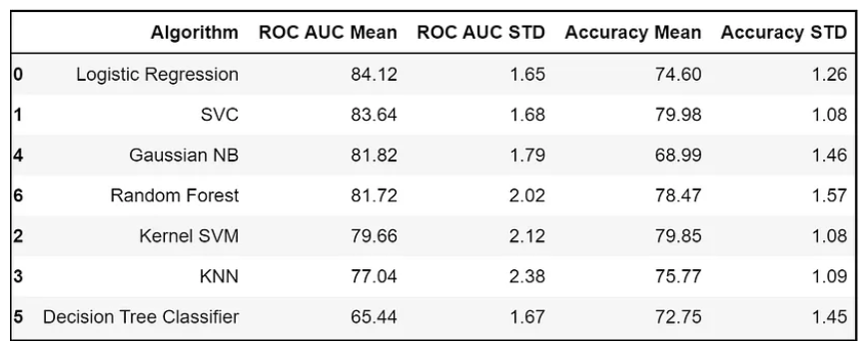
Predicting Customer Churn
Result and Analysis
From the comparisons between the various classification algorithms, we have derived to the conclusion that Logistic regression has proven to be the most accurate and efficient algorithm. After First Iteration:

Slide 22
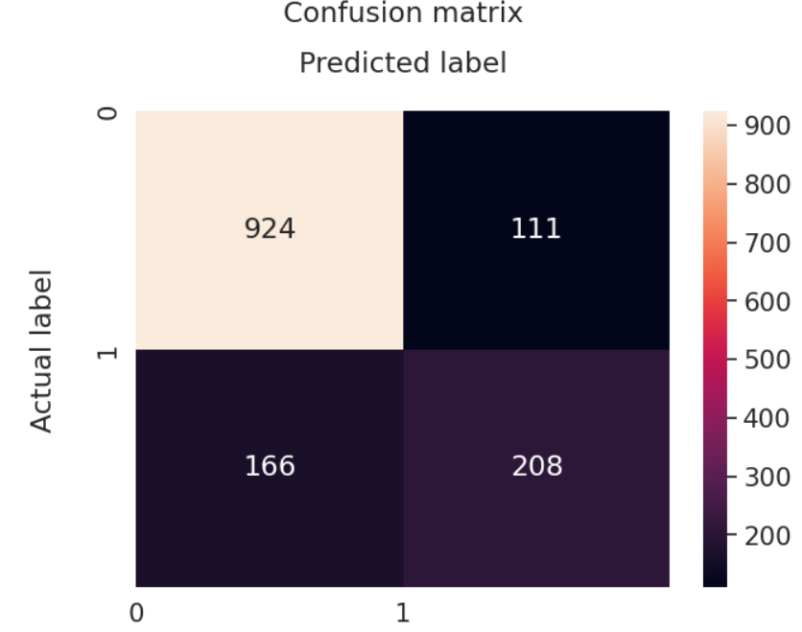
Predicting Customer Churn
Result and Analysis
After Second Iteration (Using Confusion Matrix):

Slide 23
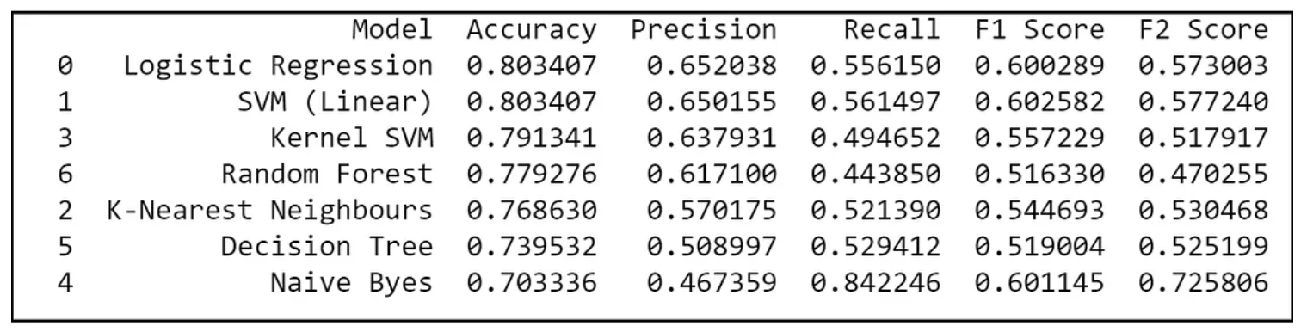
Predicting Customer Churn
Result and Analysis
After Second Iteration (Using Confusion Matrix):

Slide 24
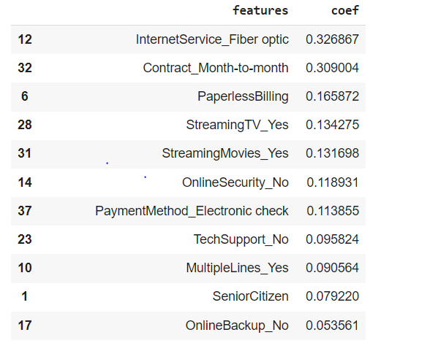
Predicting Customer Churn
Result and Analysis
Features with their Positive and Negative Correlation

Slide 25
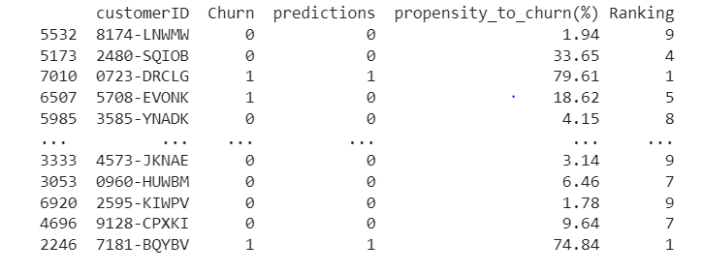
Predicting Customer Churn
Result and Analysis
Percentage of Customers expected to Churn

Slide 26
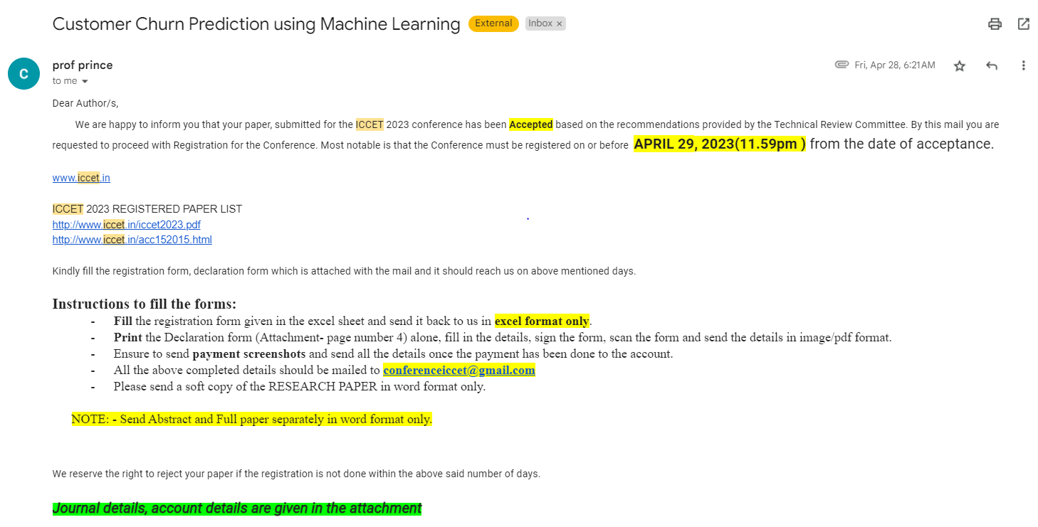
Predicting Customer Churn
Publication Details
The paper has been accepted in the ICCET 2023 conference

